Slide 1

Voxellancer
I believe I can fly
by Patrick Siegler, Sebastian Gerstenberg, Christian Dullweber and Moritz Eyssen under guidance by Daniel Limberger

Slide 2
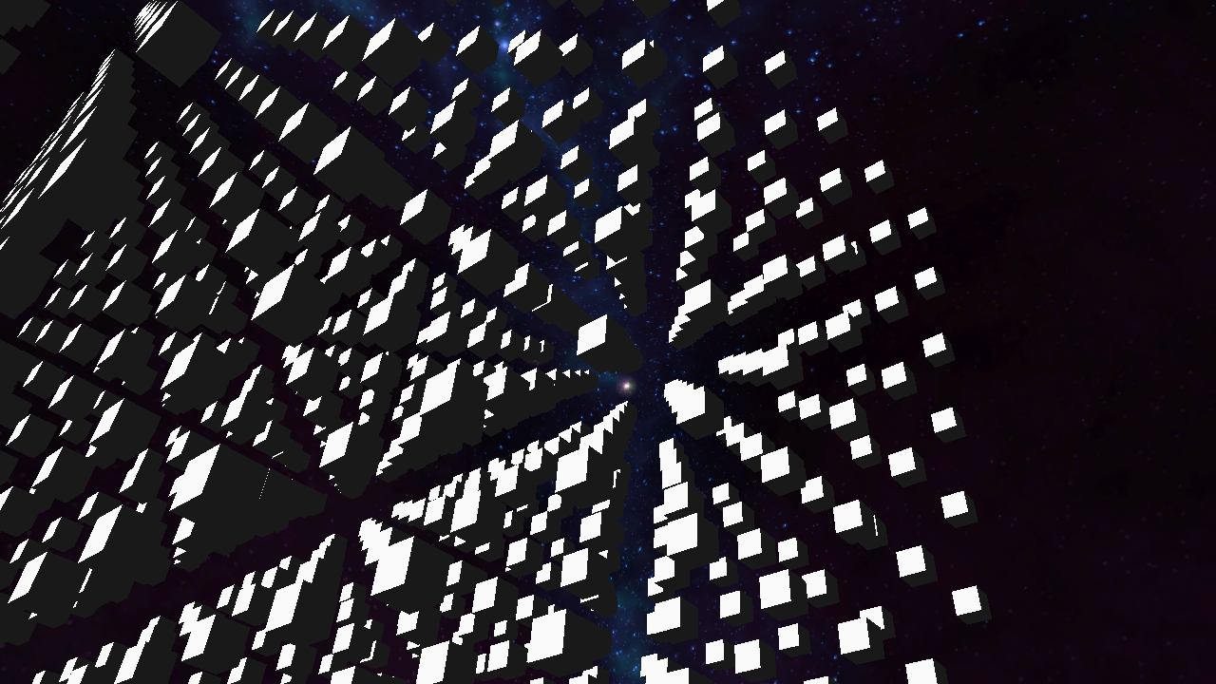

Slide 3
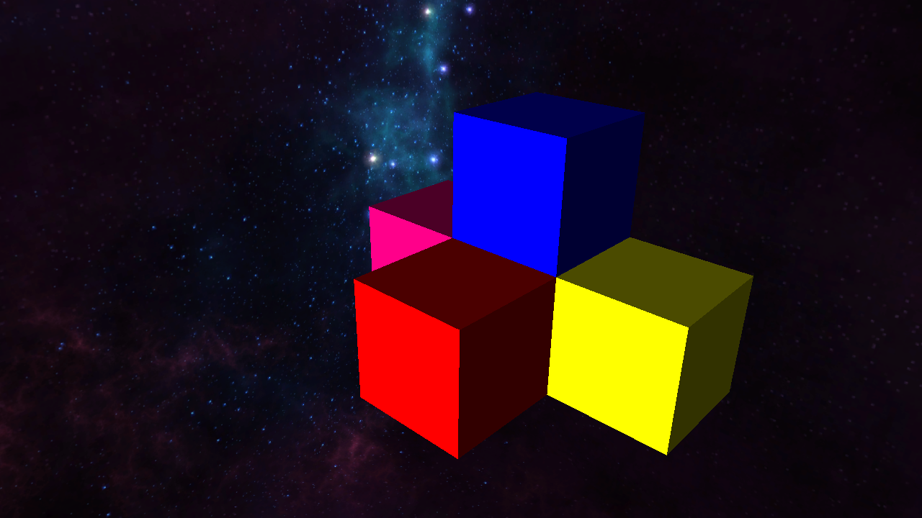

Slide 4
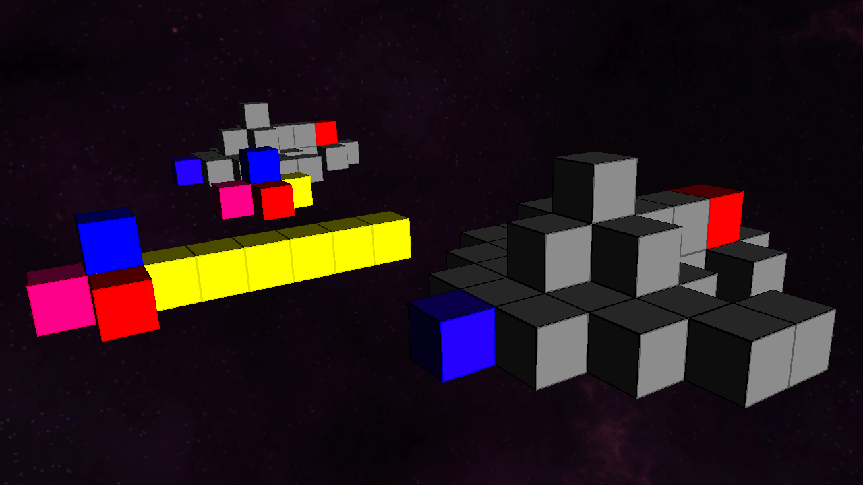

Slide 5
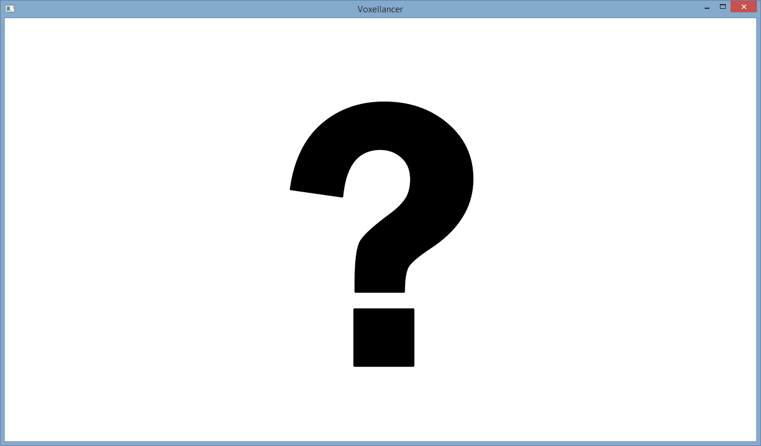

Slide 6
Done
Controllable Ship
Gamepad + Mouse
Collision Detection
Octree datastructures
Destruction
Split detection
Shooting
Physics with hooks
Laser, Rockets
HUD
First models

Slide 7
Missing
Stardust
Replaced by HUD inertia
Dumb AI ships
Performance
Should have been done according to initial milestones

Slide 8
Todo
AI
Missions
Scripts
Gameplay
Beautiful rendering
Menu

Slide 9
Libraries & Tools
GLFW
GLOW
GLEW
GLM
FMOD
Git
github.com/voxelinc/voxellancer
Jenkins

Slide 10
